Slide 1
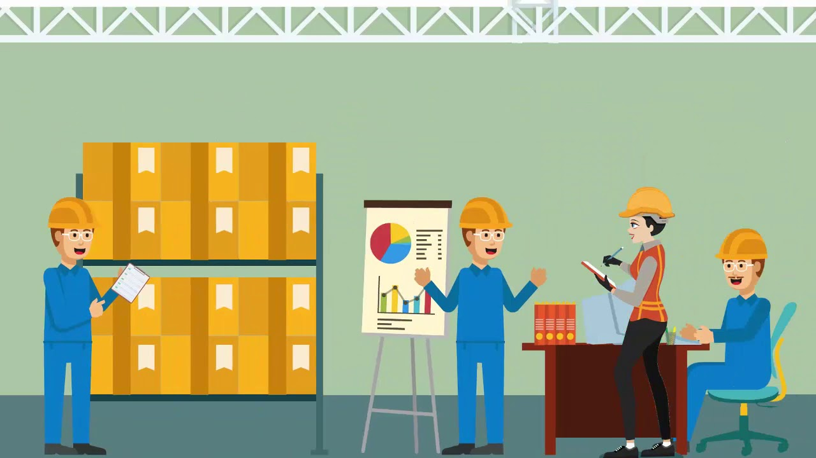
WAREHOUSE OPERATIONS
By MAEVERICK MATIBAG

Slide 2

WAREHOUSING
“A set of activities that are involved in receiving and storing of goods and preparing them for reshipment.”
– Robert Hughes

Slide 3
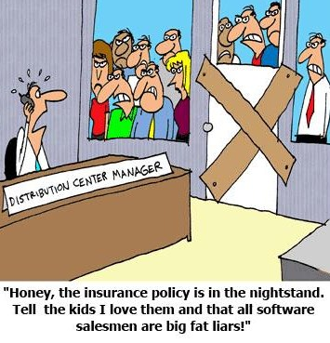
WAREHOUSING OPERATIONS
to satisfy customers’ needs and requirements while utilizing space, equipment, and labor effectively

Slide 4
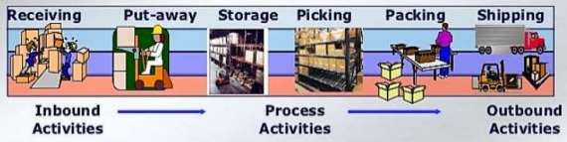
3 MAJOR ACTIVITIES OF WAREHOUSING

Slide 5
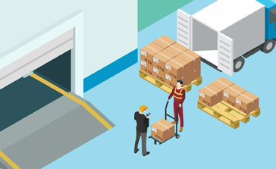
INBOUND ACTIVITIES
RECEIVING
unloading and checking the shipment
unpacking and inspecting the material
(correct item → quantity → condition)
completion of receiving report

Slide 6
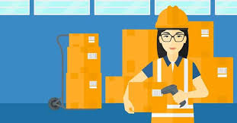
INBOUND ACTIVITIES
PUT-AWAY
scans the barcode and move to the given address
selection of warehouse location
product key
product code
size
weight
cost
color

Slide 7

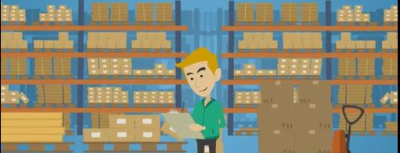
PROCESS ACTIVITIES
ORDER PICKING
process of pulling items from the inventory to fill a customer order
METHODS
Zone Picking → specific zone
Batch Picking → by batch
Wave Picking → variation

Slide 8
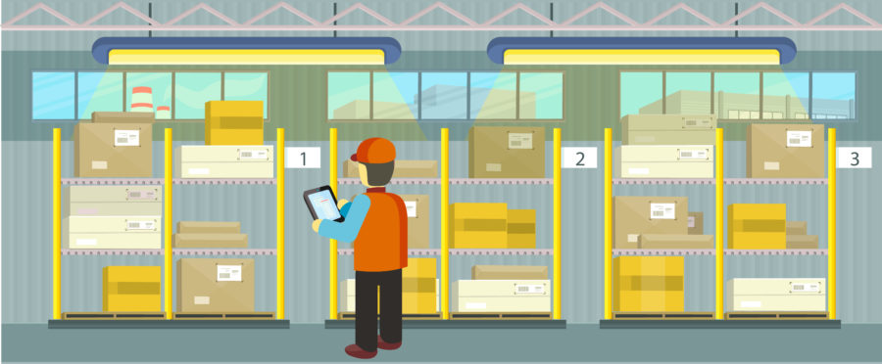
PROCESS ACTIVITIES
REPLENISHMENT
movement of inventory from upstream to downstream
keep inventory flowing through the supply chain by maintaining efficient order
prevent costly inventory overstocking

Slide 9
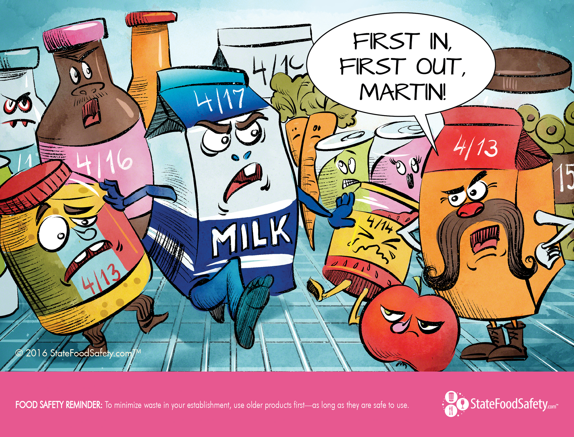
PROCESS ACTIVITIES
STOCK ROTATION
arrange the oldest units in inventory so they are sold before the newer unit
reduce the losses from deterioration and obsolescence
METHODS:
FIFO - First In, First Out
LIFO – Last In, First Out
Bar Code of Date of Manufacture System

Slide 10

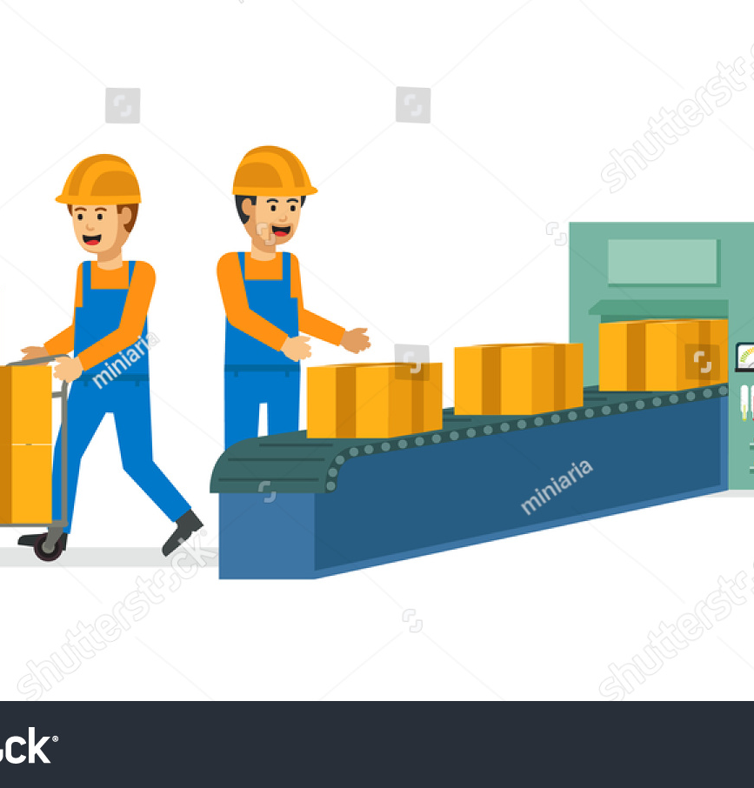
OUTBOUND ACTIVITIES
PACKING
minimize damage that can occur after an item has left the production line

Slide 11
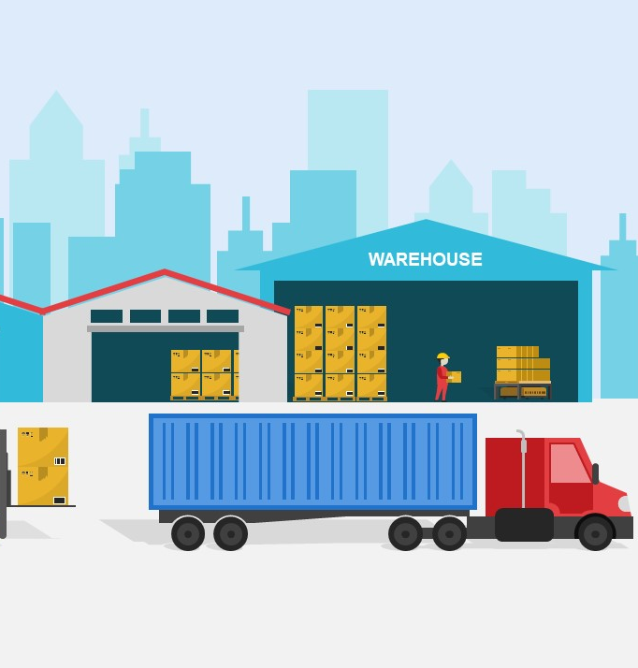
OUTBOUND ACTIVITIES
SHIPPING
confirmation → invoicing → stealing → stagging → loading

Slide 12
ARRANGING YOUR WAREHOUSE

Slide 13
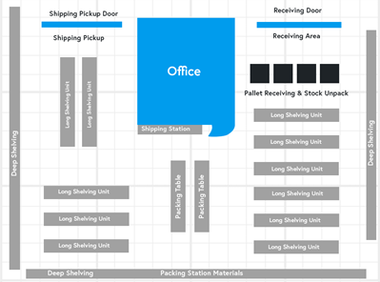
1. General warehouse layout
ARRANGING YOUR WAREHOUSE

Slide 14
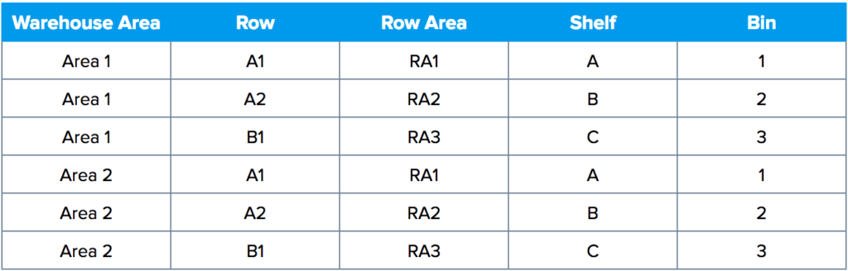
2. Labelling areas of your warehouse
ARRANGING YOUR WAREHOUSE

Slide 15
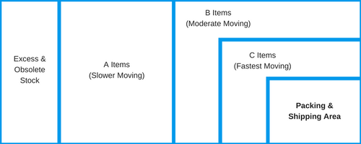
3. How to arrange inventory in the warehouse
ARRANGING YOUR WAREHOUSE

Slide 16
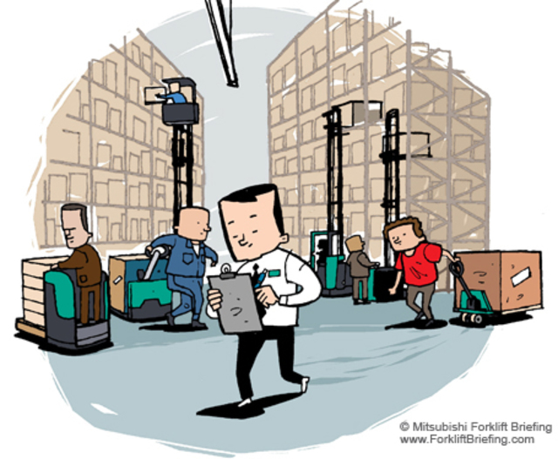
4. Don’t be afraid to rearrange
ARRANGING YOUR WAREHOUSE

Slide 17
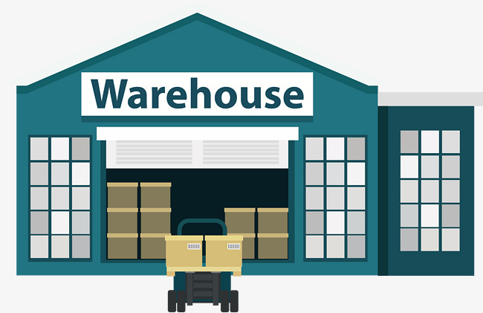
TYPES OF WAREHOUSE SPACE
Commercial: in rented building used for business.
Government or state: such as at the ports or harbors. This is common in emergency situations.
Transit: for temporary storage of goods destined for different locations and need storage for a very short time.
Bonded warehouses: for storage of goods whose duty is unpaid and especially where the goods are destined to another country. Pre-positioned stock is often held in bonded warehouses so that export is quick and can sometimes be stored for long periods.
Open storage: not ideal for perishable products but in emergencies, sometimes the only alternative.
Space that is owned and managed by the organization.
Pre-fabricated warehouses where there are no permanent structures available. This is common practice in emergencies.

Slide 18
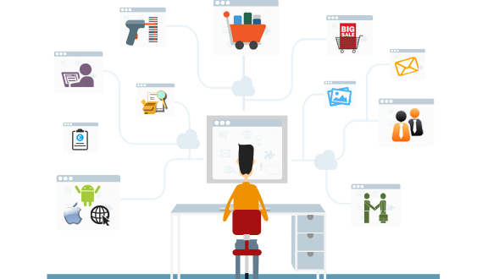
Warehouse Management System

Slide 19
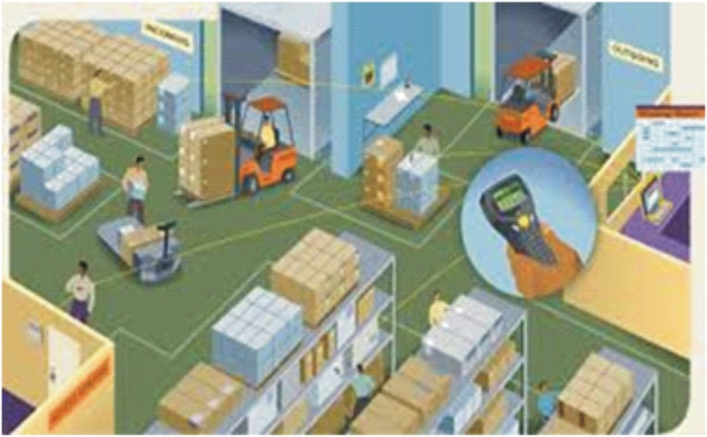
Warehouse Management System
a piece of software that controls, records and automates various warehouse operations
increase the overall productivity and efficiency of a business’ warehousing operations

Slide 20
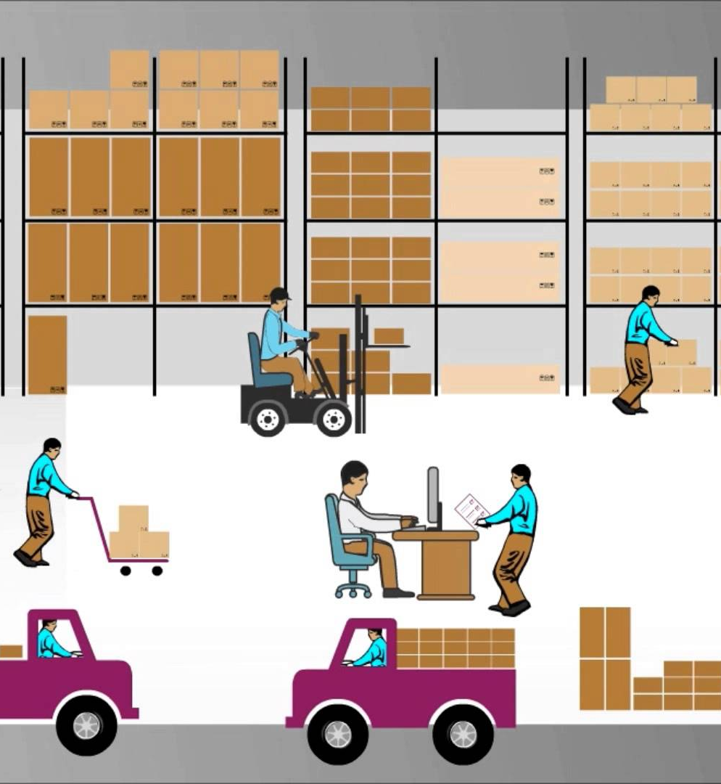
MAIN FEATURES OF WMS
Barcode scanning and radio frequency ID tagging
help with data input, tracking what, when and how many products are received, as well as where they’re stored
Order and fulfillment management
reorder tools that provide accurate information related to when orders are shipped and received.
Real-time tracking capabilities
tracking assets and orders as mentioned above, as well as the projects and schedules of your warehouse employees
Dashboard
allow users to view the data in an easy-to-understand manner, so they can get an overview on incoming/outgoing shipments and employee workloads, as well as where stock is and how much is in the warehouse

Slide 21
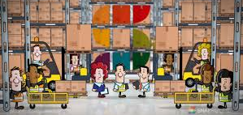
Who Uses a WMS?
Warehouse managers oversee the warehouse management process. Therefore, it shouldn’t come as a surprise that they’re the primary users of a warehouse management system. That said, however, they’re by no means the only ones who benefit from using it. Thanks to the labor management features found in most warehouse management systems, warehouse employees benefit from using WMS solutions as well. They can use it to view the orders that need to be processed and, more importantly, they can also view their schedule so they know what tasks they have to complete each day.

Slide 22

Benefits of Using a WMS
reduced operating expenses
continuous process optimization
enhanced security
improved customer and supplier relationships
maximizing their labor resources
simplifying just-in-time inventory
enhancing demand planning
increasing transparency to both employees and suppliers

Slide 23
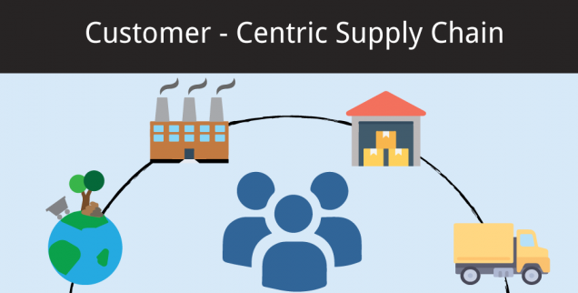
How Does Warehouse Management Affect Supply Chain Management?
Warehouse management is the central link in supply chain management. It’s the all-important bridge between producing a product and delivering it to customers. Warehouse management helps organize products to make sure that they’re shipped to the right customer at the right time. This is the most important effect on the supply chain.
If your warehouse management processes become inefficient and inaccurate, it can mess up your entire operation, sending products to the wrong location, or sending the right products late. When your customers get what they want when they want it, they’re happy. But if they don’t, chances are good that they’ll stop giving you business, and start looking elsewhere.

Slide 24

What Does Logistics Mean in Warehouse Management?
Logistics is an umbrella term for various tasks related to transportation, warehousing, inventory, information management and more. These include the various processes in the supply chain that happen before, during and after warehousing.
It’s important that the different functions of logistics work in tandem, so that your supply chain is as efficient as possible. This means that the initial transportation of goods is scheduled so that they arrive at the warehouse when there’s room for the inventory. Additionally, it means that those goods leave the warehouse on time, so they arrive at their destination exactly when they need to be there.

Slide 25
THANK YOU

